Slide 1
Exam Readiness: AWS Certified Machine Learning - Specialty

Slide 2
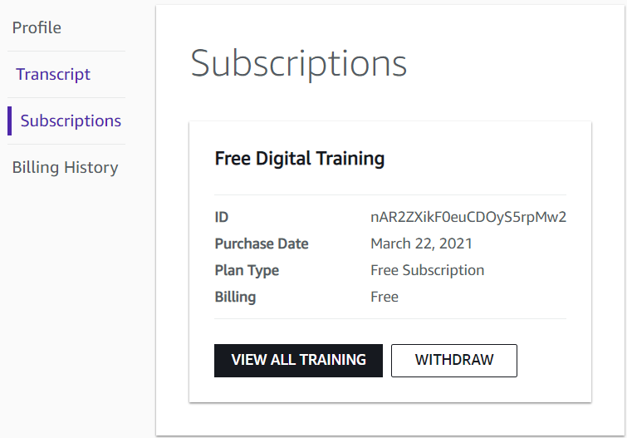
Create AWS Training Account
Welcome | AWS Training & Certification

Slide 3

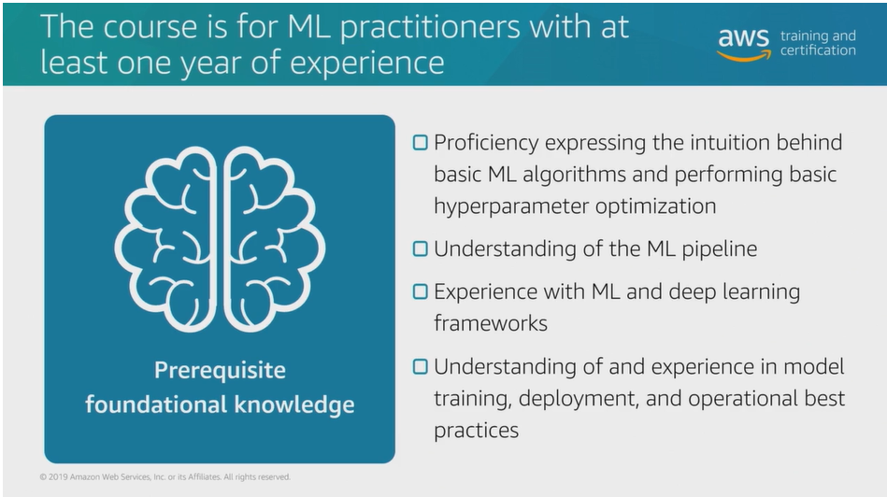

Slide 4
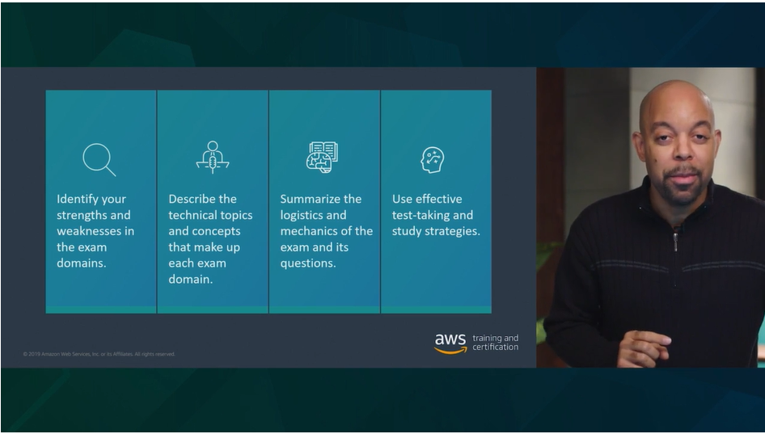

Slide 5
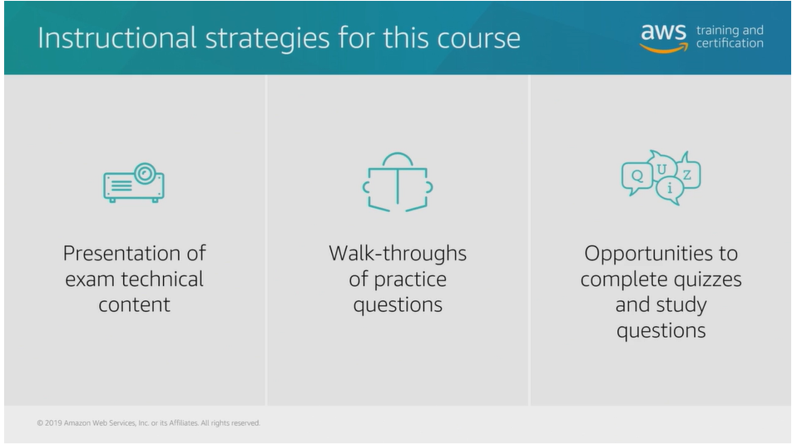

Slide 6
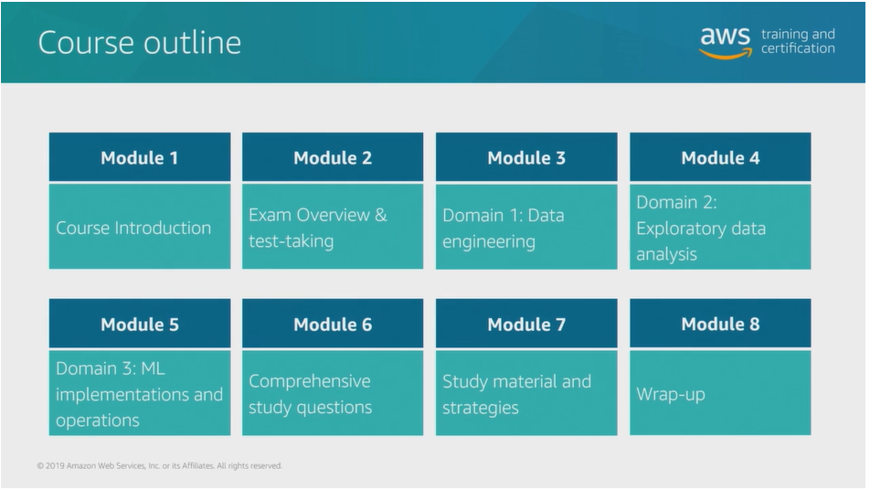

Slide 7
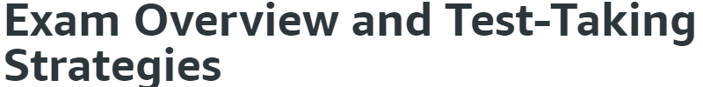
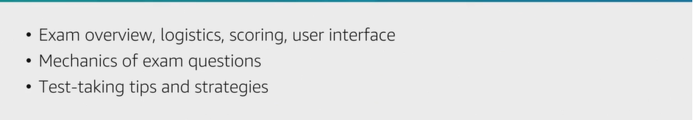
Watch this video to get a better sense of what it's like on test day at a Pearson VUE

Slide 8
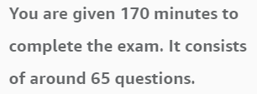
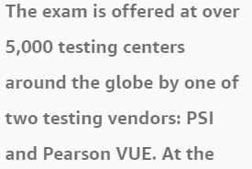
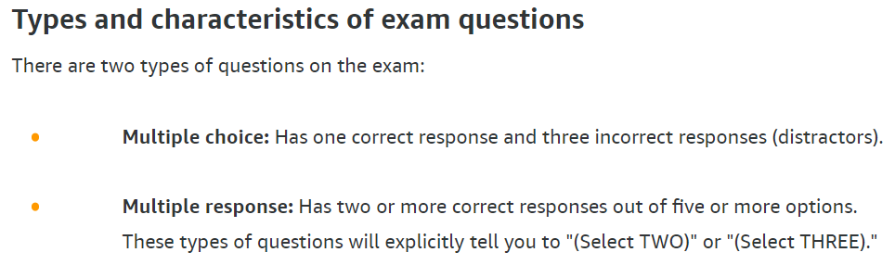
There may be some differences between testing centers, but in general, these are the requirements you'll encounter on test day:
Two forms of ID are required. One must be a government-issued ID with a photo.
You must empty your pockets and lock away your personal belongings.
You will be escorted to a test center computer to electronically take the exam.
You must sign a non-disclosure agreement before taking the exam.
Before you sit the exam, your hand print may be taken and/or a picture of you may be taken.

Slide 9
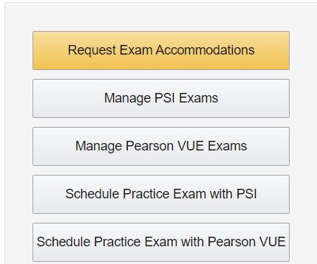

Slide 10
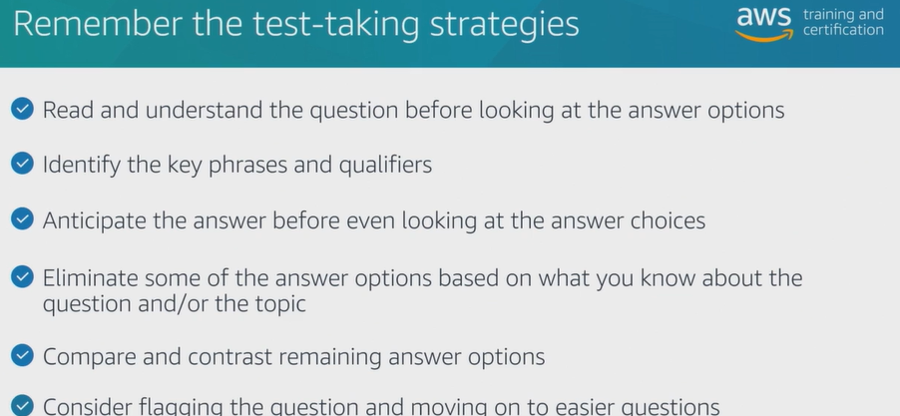

Slide 11
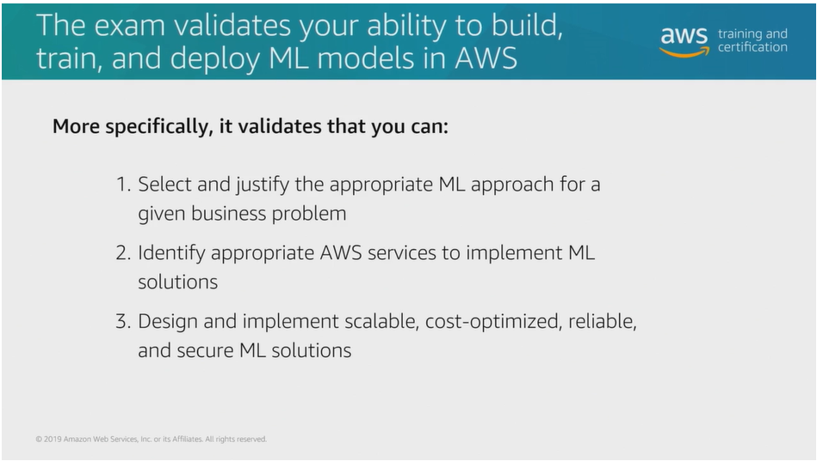

Slide 12
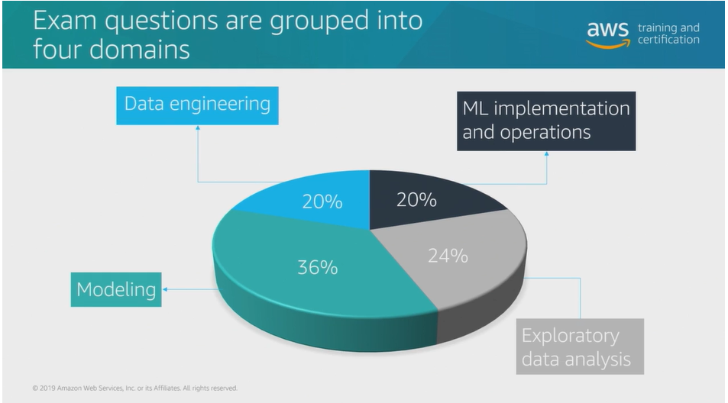

Slide 13

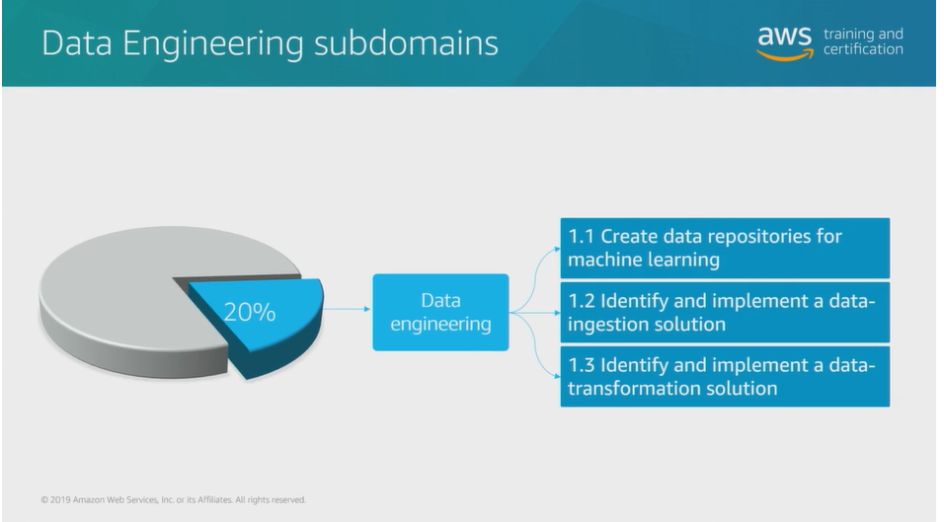

Slide 14
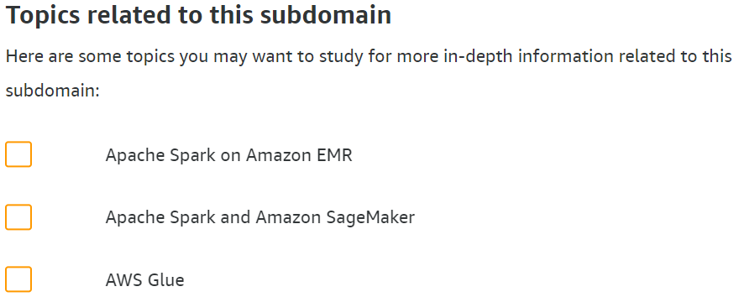



Slide 15
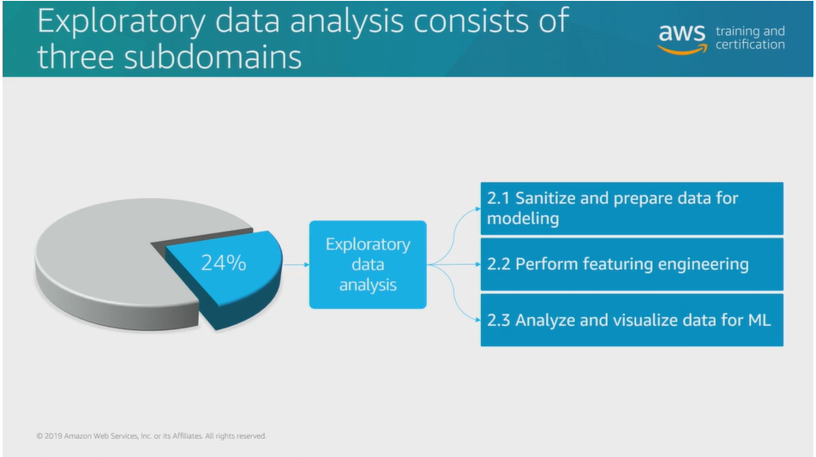

Slide 16
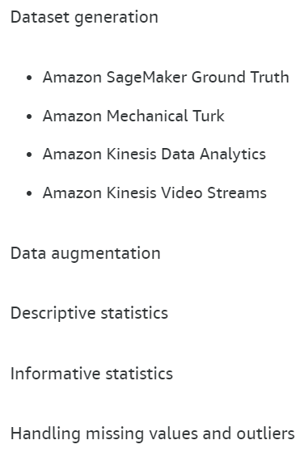
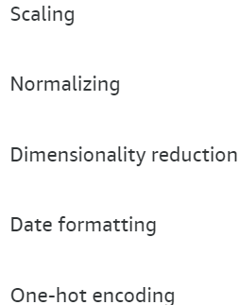
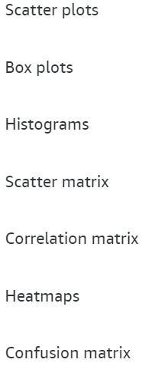
Domain 2.1: Sanitize and prepare data for modeling
Domain 2.2: Perform feature engineering
Domain 2.3: Analyze and visualize data for ML

Slide 17

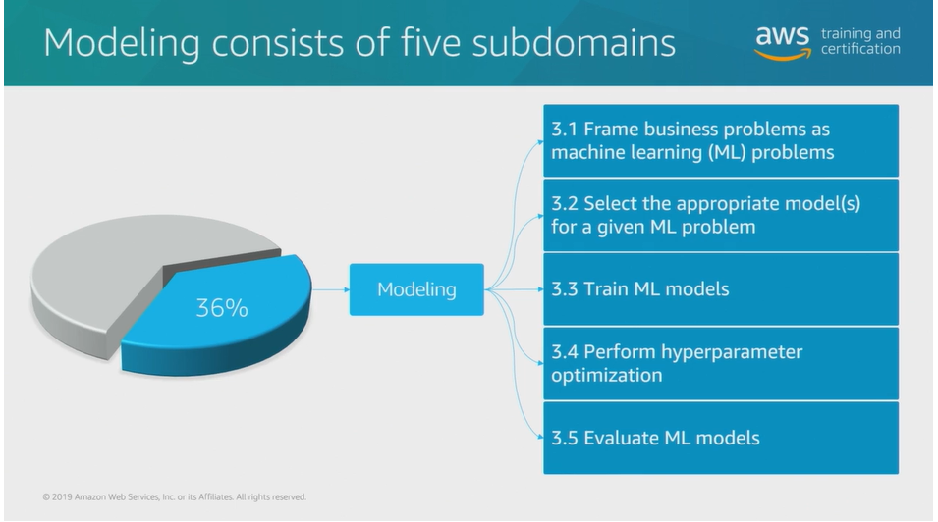

Slide 18
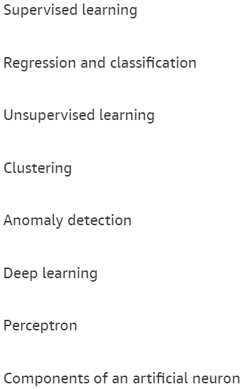
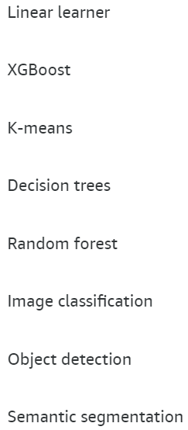
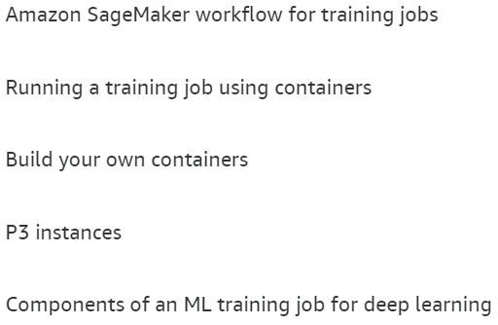
Domain 3.1: Frame business problems as ML problems
Domain 3.2: Select the appropriate model(s) for an ML problem
Domain 3.3: Train ML models

Slide 19
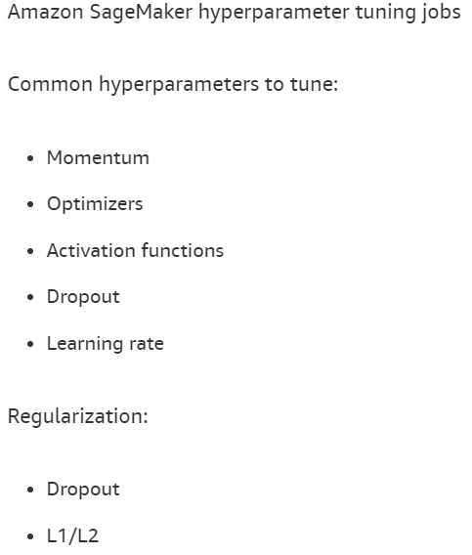
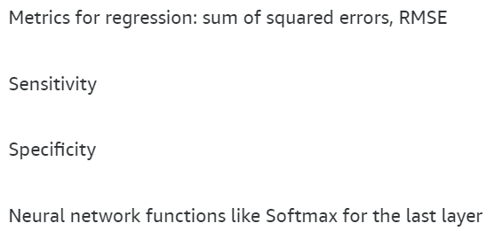
Domain 3.4: Perform hyperparameter optimization
Domain 3.5: Evaluate ML models

Slide 20

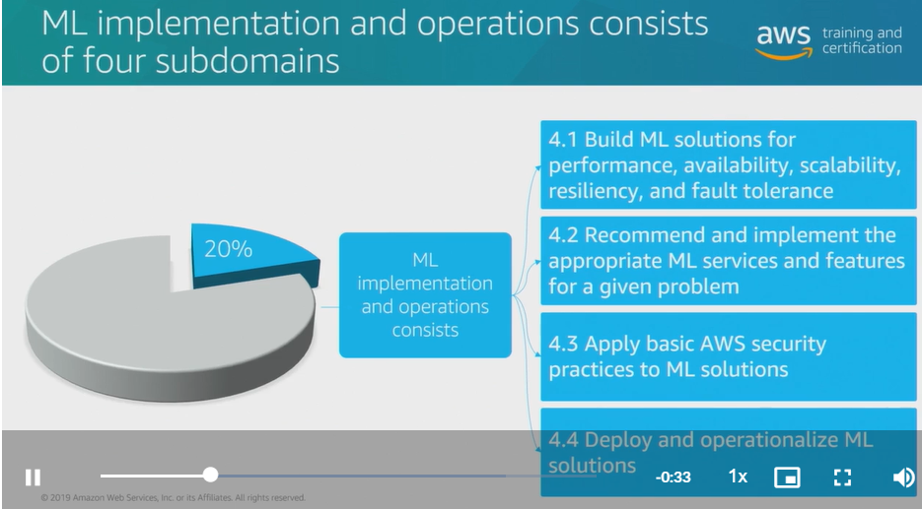

Slide 21
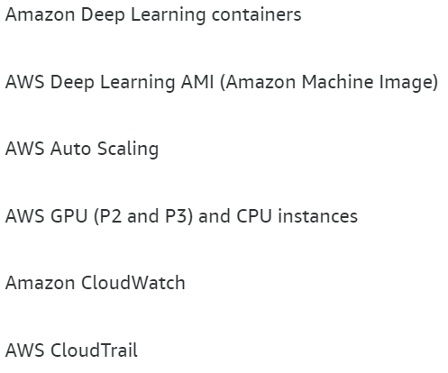
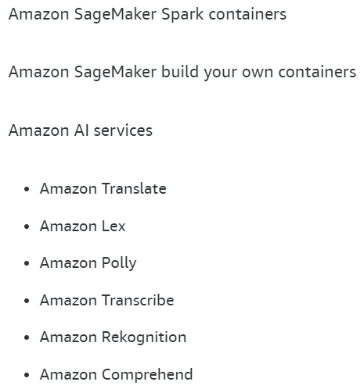
Domain 4.1: Build ML solutions for performance, availability, scalability, resiliency, and fault tolerance
Domain 4.2: Recommend and implement the appropriate ML services and features for a given problem

Slide 22
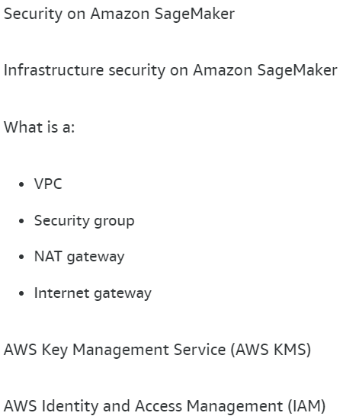
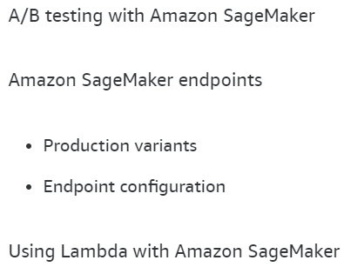
Domain 4.3: Apply Basic AWS security practices to ML solutions
Domain 4.4: Deploy and operationalize ML solutions

Slide 23

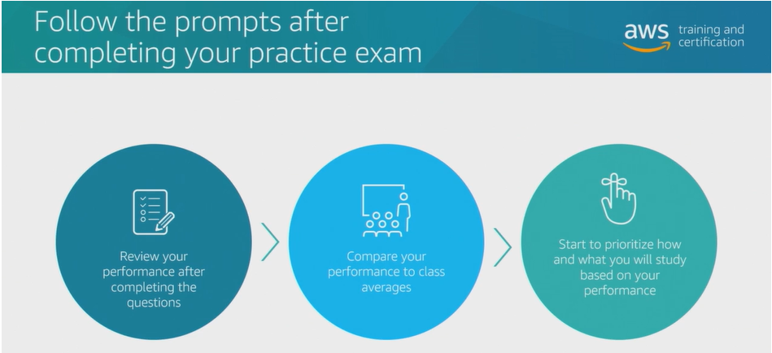
In-depth experience of taking the exam. Taking this 35-question practice exam will give you a stronger feel for what it’s like to take a certification exam and what types of technical content will be on the exam.
Feedback on your strengths and weaknesses in the exam domains.
In the actual certification exam, you may have two minutes or more to complete each question.

Slide 24


Slide 25

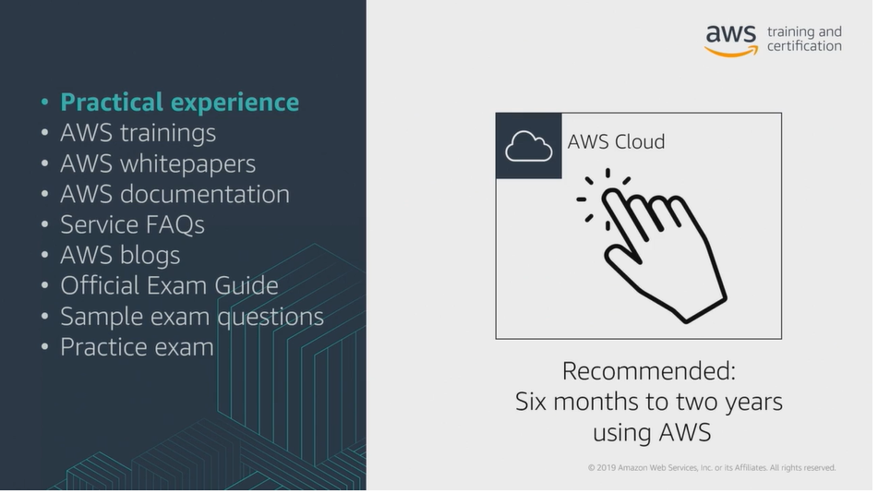

Slide 26
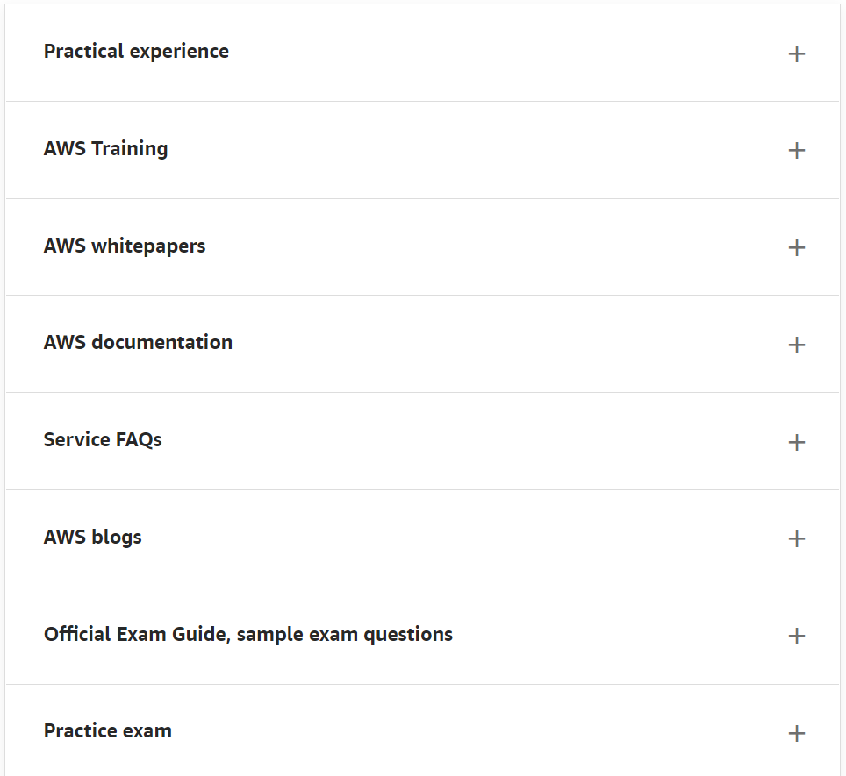

Slide 27
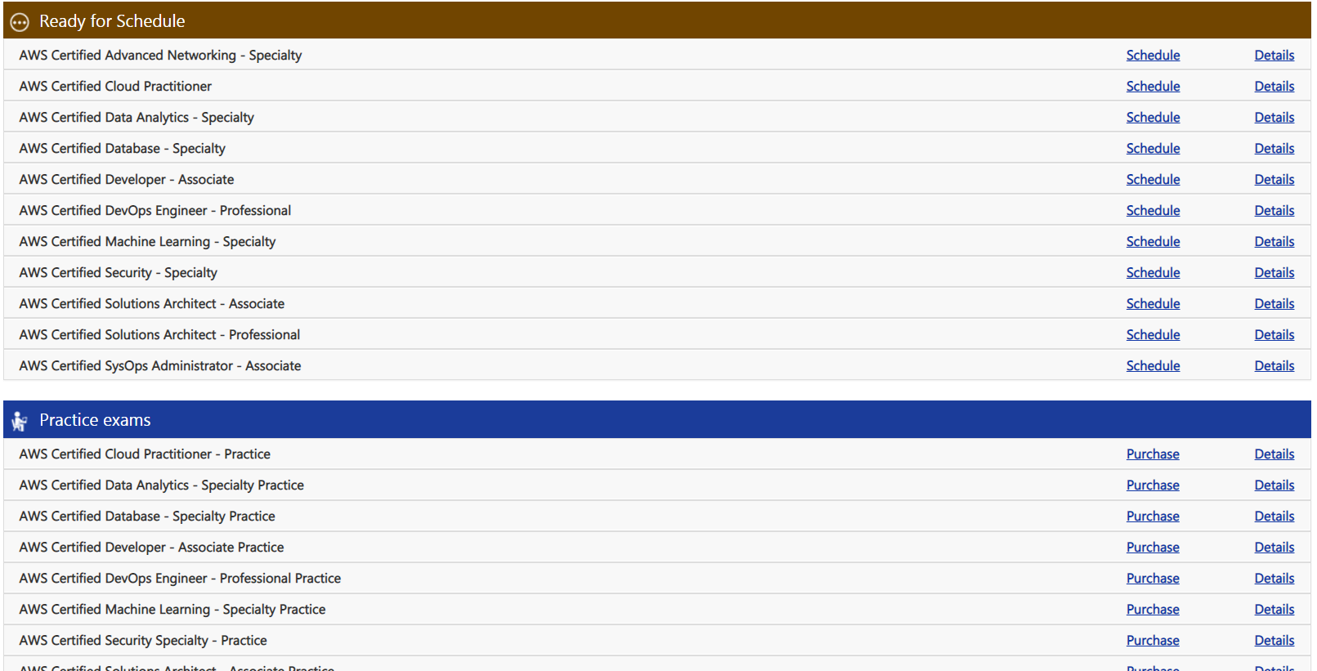
Facility to avail practice exams

Slide 28
13 questions.

Slide 29
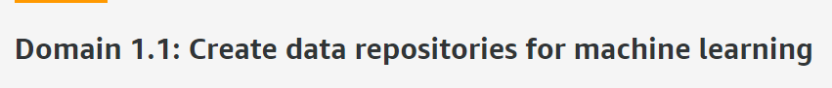
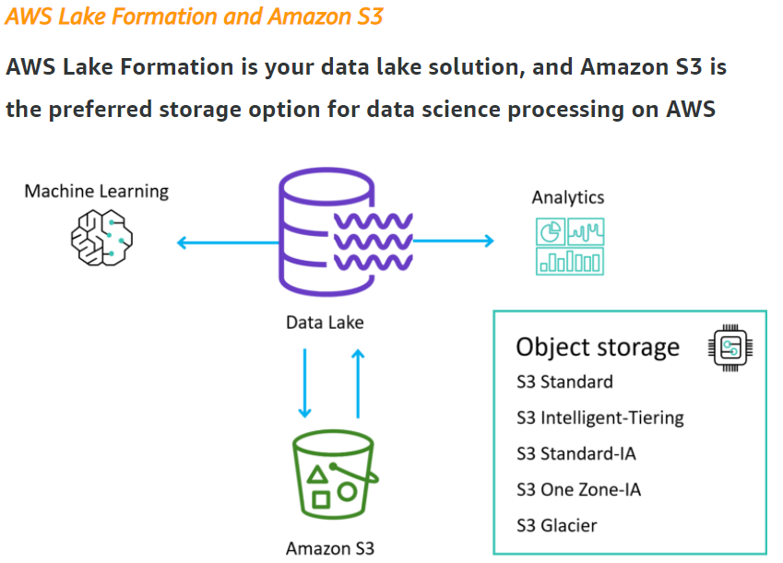
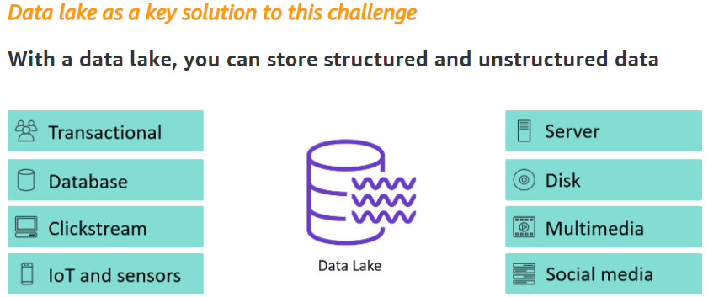
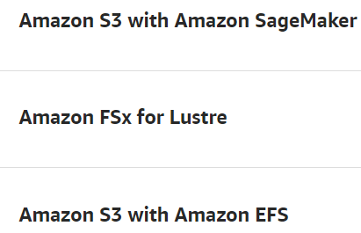

Slide 30

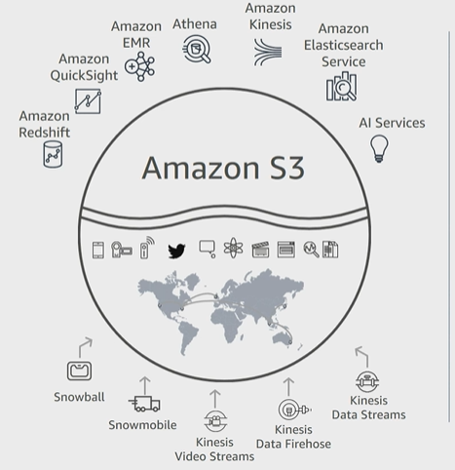
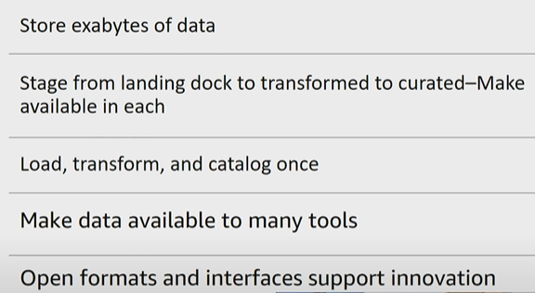

Slide 31
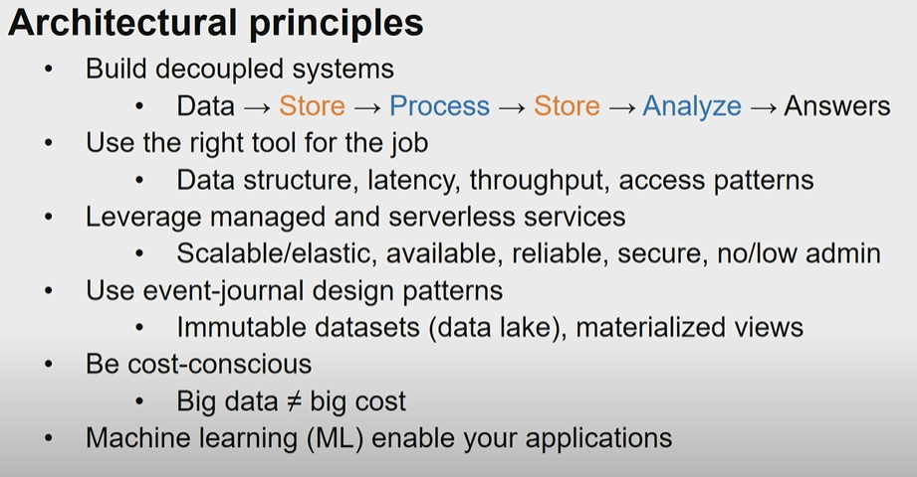

Slide 32
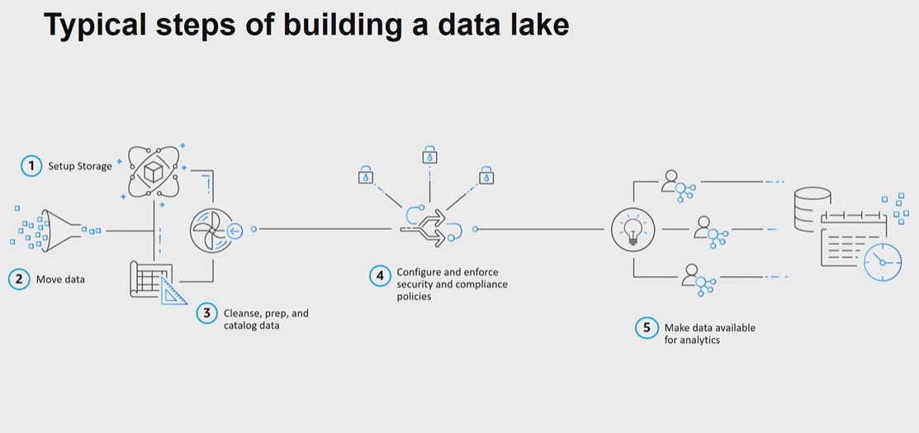

Slide 33
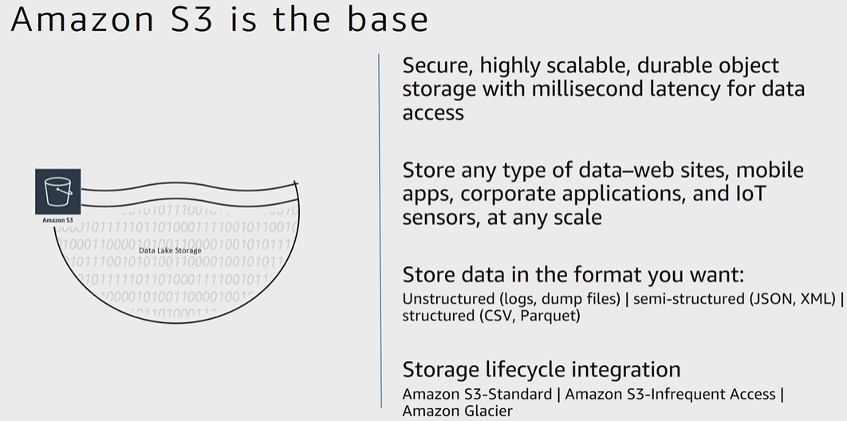

Slide 34
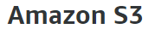
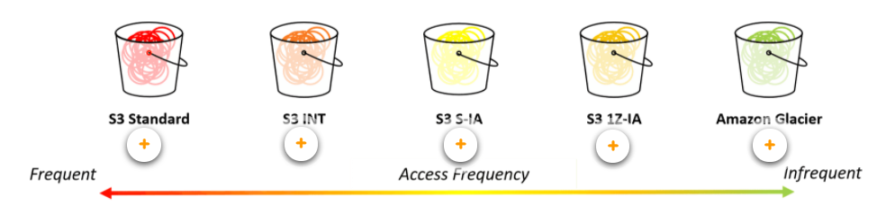
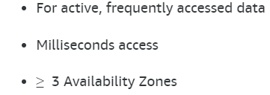
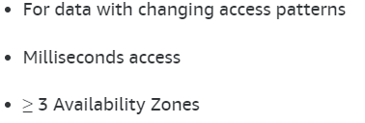
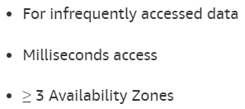
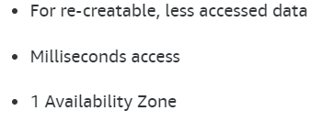



Slide 35


Slide 36




Slide 37




Slide 39




Slide 40


Slide 41


Slide 42


Slide 43


Slide 44


Slide 45


Slide 46


Slide 47


Slide 48


Slide 49


Slide 50


Slide 51


Slide 52


Slide 53


Slide 54


Slide 55


Slide 56


Slide 57




Slide 58




Slide 59



Slide 60


Slide 61


Slide 62


Slide 63


Slide 64


Slide 65



Slide 66




Slide 67


Slide 68


Slide 69


Slide 70


Slide 71


Slide 72


Slide 73


Slide 74


Slide 75



Slide 76



Slide 77


Slide 78


Slide 79

Data Warehousing
Contains tools like spark, hive, etc.

Slide 80


Slide 81


Slide 82


Slide 83


Slide 84


Slide 85


Slide 86


Slide 87


Slide 88


Slide 89


Slide 90


Slide 91


Slide 92


Slide 93


Slide 94


Slide 95


Slide 96


Slide 98


Slide 99


